Slide 1
DNA MUTATION
by Dr Shuzan Aly Lecturer of Medical Biochemistry

Slide 2
DNA Mutation
Any change in DNA molecule results in permenent alteration in the base sequence in daughter DNA.
causes:
Uncorrected errors
Damage by (oxidative deamination, radiation & chemicals)

Slide 3
Types
Point mutation
Insertion mutation
Deletion mutation
Frameshift mutation
Lethal mutation

Slide 4
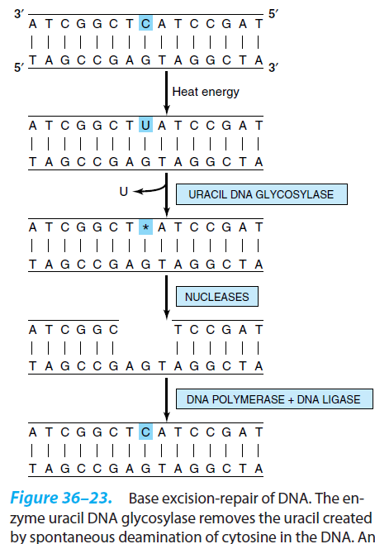

Slide 5
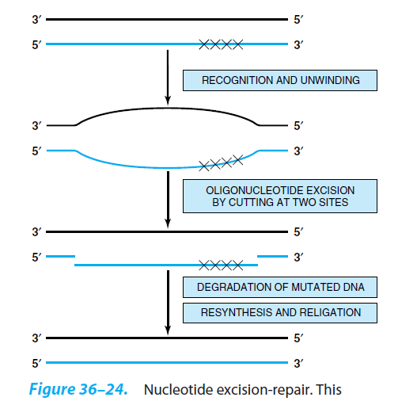

Slide 6
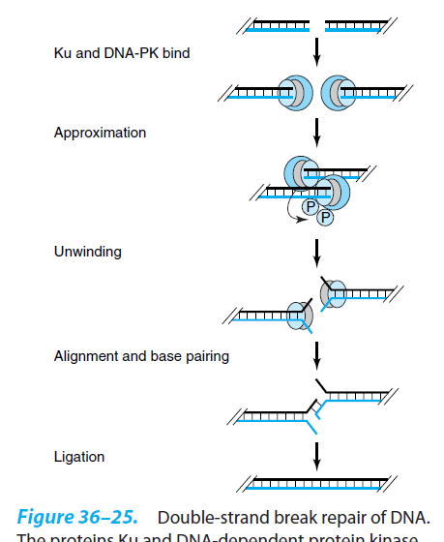

Slide 7
